Slide 1
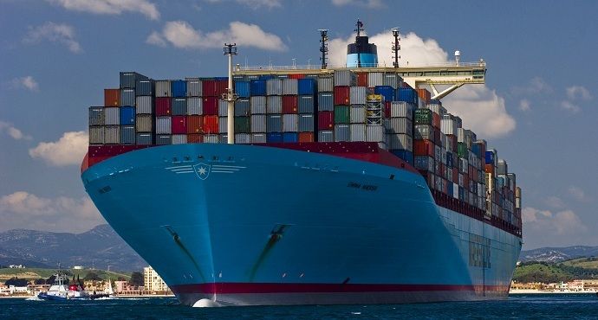
Super Ultra Large Container Vessel Operations in the Port of NY/NJ

Slide 2
Guidelines as of June 30, 2017
Super Ultra Large Container Vessel (SULCV)– any container vessel with a beam of 159 ft or greater
Simulation studies of 14,000 TEU SULCV transits completed in the Port of NY/NJ.
Working Group has established the following preliminary guidelines for transit of SULCV’s above the Narrows.
These guidelines will be amended as “hands on” experience is gained by the docking pilots.

Slide 3
Anchorage / Pilots / Weather
Prior to starting SULCV inbound from Ambrose the berth must be confirmed “clear”, and an anchorage spot should be confirmed available for bailout purposes.
Two Pilots required (excluding shifting berths). One Sandy Hook Pilot and one Docking Pilot.
SULCVs will not transit beyond the “Narrows” unless visibility in KVK is greater than 1.5 NM
SULCVs will not transit beyond the “Narrows”, if regardless of direction maximum sustained winds exceed 20 knots or maximum gusts are 25 knots or higher. Mariner’s Harbor wind gauge to be used as reference station for KVK, Robbins Reef wind gauge to be used a reference station for Port Jersey Channel.

Slide 4
Transit Windows
Transiting Bergen Point restricted to one hour either side of HW or LW Battery. Maximum of two SULCV’s transits permitted per tide window. Vessel Arrival at “Narrows” and Sailing from berth are to be set up for two (2) hours before Battery HW or LW. A minimum three foot Under Keel Clearance (UKC) shall be required for transit from the Narrows to “Off” the berth. Due to berth controlling depth, maximum draft 49’0”.
Transiting Port Jersey Channel to/ from Global Terminal restricted to vessel arrival at Narrows and Sailing from berth with draft 47’‐00” or more to be set up for one to two hours after Battery HW. Vessel arrival at Narrows and Sailing from berth with draft less than 47’‐00” to be set up for one to two hours after Battery LW A minimum three foot Under Keel Clearance (UKC) shall be required for transit from the Narrows to “Off” the berth. Maximum draft 49’00”.

Slide 5
Number of Tugs
TWO (2) tugs to be available at the “Narrows” with a docking pilot aboard one of the tugs. This will provide for immediate tug assistance should a vessel be required to turn around, and either anchor or return to sea in the event the ship cannot continue into the KVK or Port Jersey. (Visibility restrictions or other impediment) The docking pilot and the Sandy Hook Pilot will communicate as necessary.
For SULCVs with a working bow thruster bound into the Kill Van Kull (KVK), TWO (2) additional tugs will be assigned from KVK LB 9 to the Berth. For vessels bound for Port Jersey TWO (2) additional tugs will be assigned from Robbins Reef.
For SULCVs without a working bow thruster bound into the Kill Van Kull, five (5) tugs will be assigned from KVK LB9 to the Berth. For vessels bound for Port Jersey a fifth tug boat MAY be assigned at Robbins Reef (docking pilot to assess need based upon handling characteristics of vessel and tidal conditions)
Note: With regards to the 3 items above, in the event that vessel handling characteristics dictate the use of special purpose escort tractor tugs tethered and operated in the “direct”, "arrest" or “indirect” mode, special purpose escort tractor tugs will be substituted as requested by the docking pilot.

Slide 6
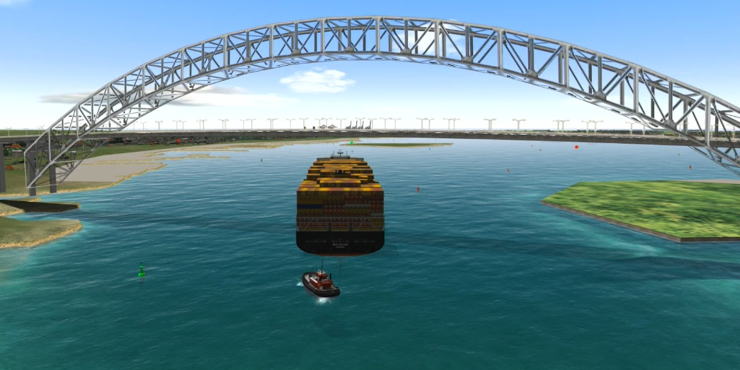
No Meet / No Overtake
No vessels greater than 500 feet (including ATB’s, and tugs with tows) may meet or overtake an SULCV while the SULCV is transiting the Kill Van Kull (KVK) and Port Elizabeth Channel, unless agreed to by the docking pilot.

Slide 7
Bunkering
No bunker barges allowed alongside a vessel berthed along the Kill Van Kull (KVK) or Port Elizabeth Channel while a SULCV passes.

Slide 8
Additional Restrictions
All vessels required to go BOW in and back out.
Port Jersey Channel – There cannot be a cruise ship at Bayonne Cruise Terminal and a vessel at NEAT at the same time. One or the other acceptable.
SULVC capable berths: All berths on the face of Port Elizabeth, PNCT B61, Maher B66, B68, B72, and Global Terminal.

Slide 9
Surge Potential
With larger vessels transiting the Kill Van Kull, pushing more water there will be potential for an increase in surge for vessels tied up and moving cargo in the area.
In recent months there have been two separate surge issues, one most recently causing all lines to part as well as the transfer hose(s), resulting in a spill of approx 800 gallons of gasoline into the Marine Environment.

Slide 10
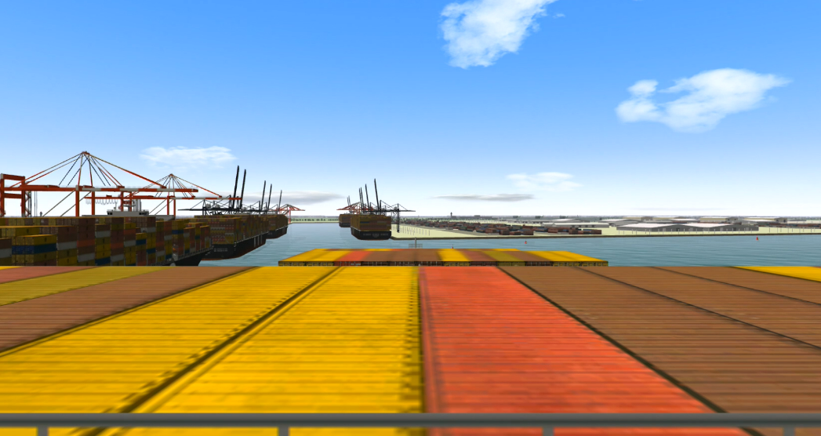
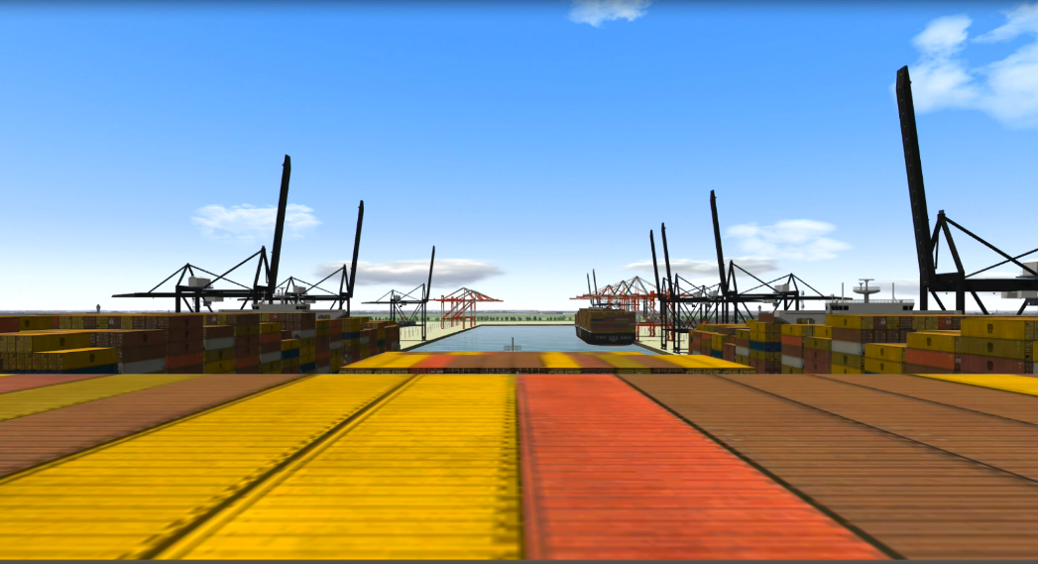
Terminal Obligations
Cranes must be centered in berth and stopped until vessel is alongside and all fast.
Cranes must be fully boomed up.
Head lines and Stern lines cannot be more than two lines per bollard.
There must be 100 feet between ships at adjacent berths.
There must be a minimum of 475 feet of useable channel between berthed vessels at opposite berths along Port Elizabeth Channel.

Slide 11
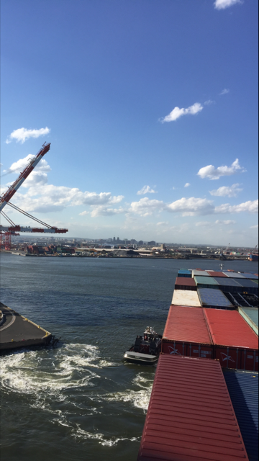
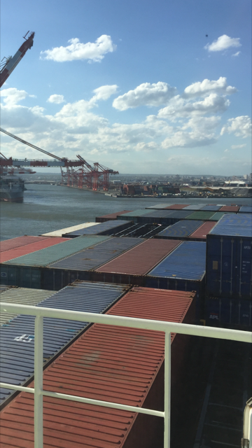
Crane Configuration

Slide 12
Questions?

